Slide 1
Lesson : JavaScript

Slide 2
Introduction
Developed by Brendan Eich 1995.
Initially called Mocha, then LiveScript.
First day of light in a beta of Netscape 2 in December 1995.
IE followed suit with JScript in 1996

Slide 3
Difference Between Java and JavaScript
Java :
Programming Language.
Object Oriented Programming Language.
Strongly typed language and type checking done at compile time.
Object in java are static.
( data members and method will known at compile time )
JavaScript :
Scripting Language.
Not a Object Oriented Language (Object model is different than OOPL)
Variables need not be declared before their use.Compatibility checking done at dynamically.
Object are dynamic ( we can change data members and method at run time.

Slide 4
Features of JavaScript
No Need of special Plugin , All browsers are currently support JavaScript.
Support commonly structured language type syntax.
It automatically insert semicolon , hence no need to add semicolon.
Data type is bound to the value and not to variable
We can assign integer to value to variable “a”
Later on we can change value to string .
4. Using eval function expression can be evaluated at run time
5. Support object, but handling is totally different from OOPL
6. Support regular expression ( [abc] , [^abc] ,[0-9] ,[^0-9] ,(x|y))
6.1 which is used to matching text-pattern.
6.2 used for validation.
7. Function can be used
Browser Support
Structure Programming Syntax
Dynamic Typing
Run Time Evaluation
Support of Object
Regular Expression
Function Programming

Slide 5
Internal JavaScript
in HTML
<!DOCTYPE html>
<html>
<body>
<h2>My First Web Page</h2>
<p>My First Paragraph.</p>
<p id="demo"></p>
<script>
document.getElementById("demo").innerHTML = 5 + 6;
</script>
</body>
</html>
Output:
My First Web Page
My First Paragraph.
11
<script type=”text/ Javascript>
…………..
……………
……………
……………
<script>

Slide 6
External JavaScript
<script type=”text/javascript src=”myjavascript.js> </script>
<!DOCTYPE html> <html> <body> <h2>External JavaScript</h2> <p id="demo">A Paragraph.</p> <button type="button" onclick="myFunction()">Try it</button> <p>(myFunction is stored in an external file called "myScript.js")</p> <script src="myScript.js"></script> </body> </html>
function myFunction() { document.getElementById("demo").innerHTML = "Paragraph changed."; }
JavaScript in Body Paragraph changed. Try it

Slide 7
Variables (i.e. buckets)
var my_var;
var another_var, yet_another_var;
var my_var;
var another_var, yet_another_var;
var MYVAR,
myvar,
myVar,
MyVar,
MyVaR;
function myFunc()
{
var my_var = false;
}
my_var; // undefined
Variable Declaration
Variable Scope

Slide 8
Data Types
Strings
var single_quoted = 'my text',
double_quoted = "more text";
var no_escape_necessary = 'some "text"',
escaped = 'some \'text\'';
var numeric_string = '06517';
Numbers
var positive = 34,
negative = -1,
decimal = 3.14;
Boolean
var yes = true,
no = false,
also_yes = 1, // truthy
also_no = 0; // falsey

Slide 9
Data Type : Array
var my_cats = [ ];
my_cats[0] = 'Sabine';
my_cats[1] = 'Dakota';
my_cats; // ['Sabine','Dakota']
var sabine = [
'Sabine', // 0 = name
'cat', // 1 = type
'female', // 2 = gender
17, // 3 = age
true // 4 = spayed/neutered
];
sabine[2]; // 'female'

Slide 10
Data type : Objects
var sabine = { };
sabine.name = 'Sabine';
sabine.type = 'cat';
sabine.gender = 'female';
sabine.age = 14;
sabine.fixed = true;
sabine; // Object
sabine['name']; // 'Sabine'
sabine.name; // 'Sabine'

Slide 11
Operators
var one = 2 - 1,
two = 1 + 1,
three = 9 / 3,
four = 2 * 2,
five = three + two;
Concatenation
'This is a ' + ' string ' ; // 'This is a string'

Slide 12
Operator : Comparison
var my_var = 1;
my_var > 2; // false
my_var < 2; // true
my_var == 2; // false
my_var >= 2; // false
my_var <= 2; // true
my_var != 2; // true
my_var === 2; // false
my_var !== 2; // true

Slide 13
Operators: Identity
function isTrue ( value )
{
return value === true;
}
isTrue( true ); // true
isTrue( false ); // false
isTrue( 1 ); // false
isTrue( 0 ); // false

Slide 14
Operators: Logical
if ( ! my_var )
{
// my_var is false, null or undefined (not)
}
if ( my_var > 2 && my_var < 10 )
{
// my_var is between 2 and 10 (exclusive)
}
if ( my_var > 2 || my_var < 2 )
{
// my_var is greater or less than 2
// (i.e. my_var != 2)
}

Slide 15
Operators: Logical
if ( ! ( my_var < 2 ) )
{
// my_var is not less than 2
// (or my_var >= 2)
}
if ( ( my_var > 2 &&
my_var < 10 ) ||
my_var == 15 ) )
{
// my_var is between 2 and 10 (exclusive)
// or my_var is 15
}

Slide 16
Data type: Dynamic typing
var my_var = false; // boolean
my_var = 14; // number
my_var = "test"; // string
my_var = []; // array
my_var = {}; // object
my_var = function(){}; // function

Slide 17
Control Structures
Conditional Action
If (Condition )
{
Statement;
}

Slide 18
Conditional Action
if ( height > 6 )
{
console.log( 'you are tall' );
}
else if ( height > 5.5 )
{
console.log( 'you are of average height' );
}
else
{
console.log( 'you are shorter than average' );
}

Slide 19
For Loop
for ( var i=1; i<=10; i++ ) { console.log( i ); }
// 1, 2, 3, 4, 5, 6, 7, 8, 9, 10
var i = 1; for ( ; i<=10; ) { console.log( i++ ); }
// 1, 2, 3, 4, 5, 6, 7, 8, 9, 10

Slide 20
While Loop
var i = 1;
while ( i < 10 ) { console.log( i ); i += 2; }
// 1, 3, 5, 7, 9

Slide 21
Functions
Function name (arguments)
{
Statements;
}
function isTrue( value ) { return value === true; } isTrue( true ); // true isTrue( false ); // false isTrue( 1 ); // false isTrue( 0 ); // false

Slide 22
Objects
var Foo = { };
Foo.value = ‘bar’;
Foo.doSomething = function()
{ console.log( this.value ); };
Foo.doSomething(); // ‘bar’

Slide 23
Almost Everything is an Object
var str_a = '1 2 3 4 5', str_b = '6 7 8 9'; str_a.length; // 9
str_a.concat( ' ', str_b ); // '1 2 3 4 5 6 7 8 9'
str_a.indexOf( '1' ); // 0
str_a.lastIndexOf( ' ' ); // 7

Slide 24
var arr = [ 1, 2, 3, 4, 5 ]; arr.reverse();
arr.length; // 5 arr; // [ 6, 4, 3, 2, 1 ]
arr.join( ' ' ); // '1 2 3 4 5' arr.shift(); // 6
arr.pop(); // 5 arr.unshift( 5 ); // 5 (the new length)
arr; // [ 1, 2, 3, 4 ] arr; // [ 5, 4, 3, 2, 1 ] arr.push( 6 ); // 5 (the new length) arr; // [ 1, 2, 3, 4, 6 ]

Slide 25
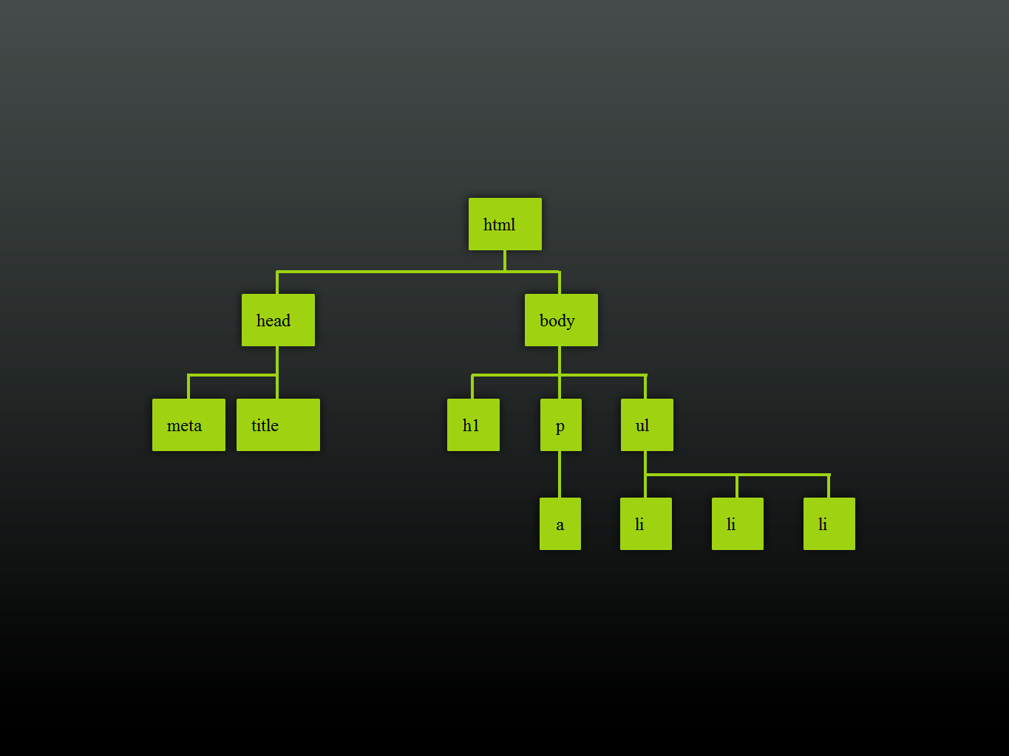
DOM (Document Object Model )
<!DOCTYPE html> <html lang="en"> <head><meta charset=”utf-8"> <title>Page Title</title> </head> <body> <h1>This is a heading</h1> <p>This is a paragraph with a <a href="http://blog.easy-designs.net">link</a>.
</p> <ul> <li>a list item</li> <li>another list item</li> <li>a third list item</li> </ul> </body> </html>

Slide 26
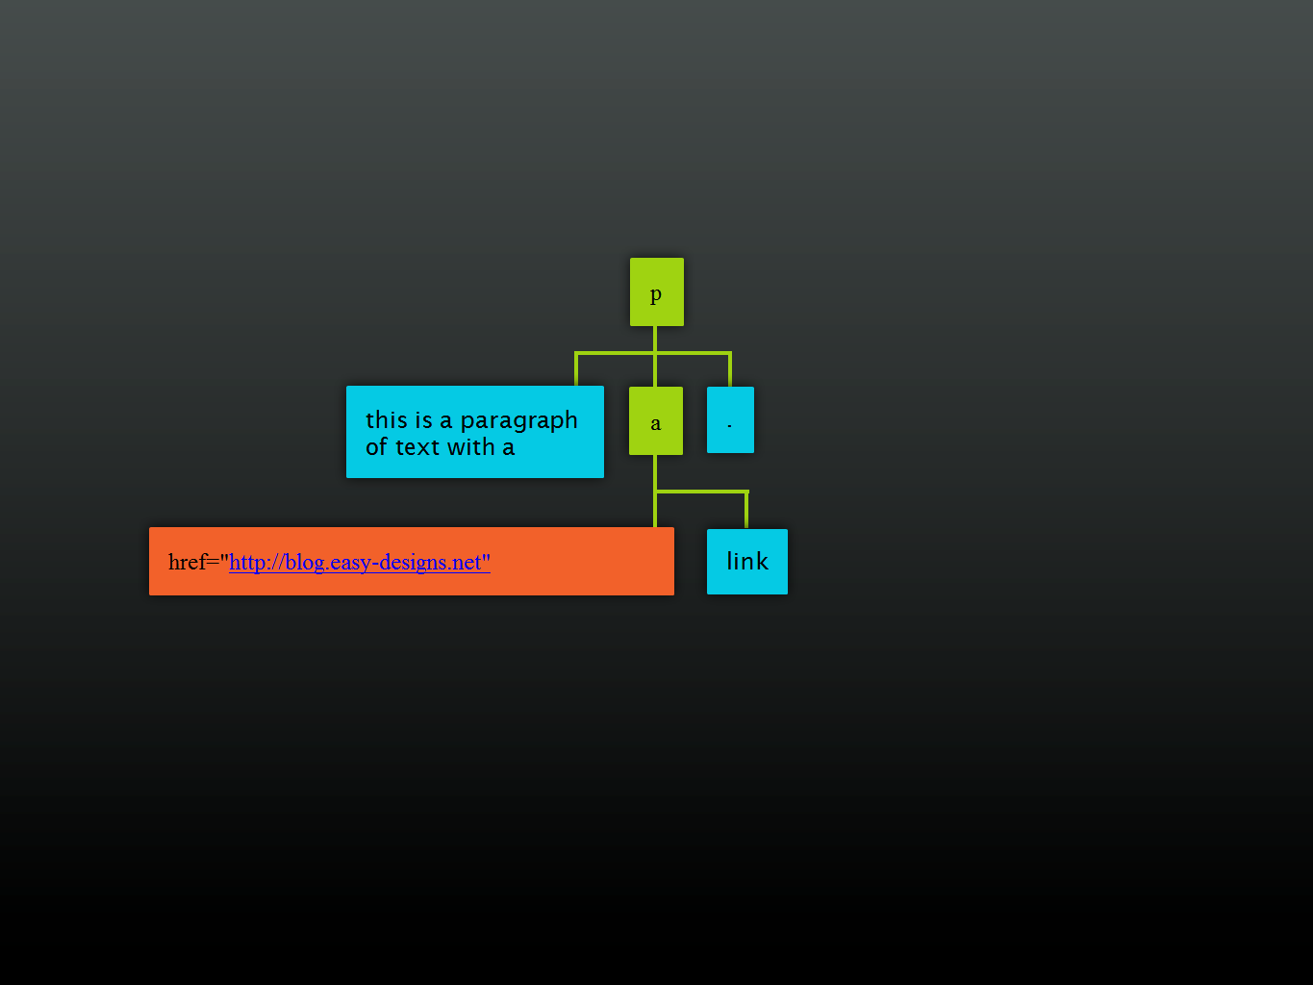

Slide 27
Find stuff (CSS)
p { color: red; }
#footer { border: 1px solid; }
#footer p { color: black; }

Slide 28
Find stuff (Javascript)
document.getElementsByTagName( 'p' );
document.getElementById( 'footer' );
document.getElementById( 'footer' ) .getElementsByTagName( 'p' );

Slide 29
Object : Math
Method | Description
abs(x) | Returns the absolute value of x
ceil(x) | Returns the value of x rounded up to its nearest integer
cos(x) | Returns the cosine of x (x is in radians)
exp(x) | Returns the value of E^{x}
floor(x) | Returns the value of x rounded down to its nearest integer
log(x) | Returns the natural logarithm (base E) of x
max(x, y, z, ..., n) | Returns the number with the highest value
min(x, y, z, ..., n) | Returns the number with the lowest value
pow(x, y) | Returns the value of x to the power of y
random() | Returns a random number between 0 and 1
round(x) | Returns the value of x rounded to its nearest integer
sin(x) | Returns the sine of x (x is in radians)
sqrt(x) | Returns the square root of x
tan(x) | Returns the tangent of an angle

Slide 30
Object: Date
Method | Description
getDate() | Get the day as a number (1-31)
getDay() | Get the weekday as a number (0-6)
getFullYear() | Get the four digit year (yyyy)
getHours() | Get the hour (0-23)
getMilliseconds() | Get the milliseconds (0-999)
getMinutes() | Get the minutes (0-59)
getMonth() | Get the month (0-11)
getSeconds() | Get the seconds (0-59)
getTime() | Get the time (milliseconds since January 1, 1970)

Slide 31
Strings
Method | Description
Concat(“string1”,”string2”) | Combines one or more strings return : string
String.length | Calculate length of string return : number
String.charAt(postion) | Returns the character at position return : character
String.toUpperCase() | Return uppercase string
String.toLowerCase() | Returns lowercase string
String.indexOf(“char”) | Return first index of character in string return : number
String.lastIndexOf(“char”) | Return last index of character in string return : number
String.slice(from,to) | Return sliced string
String.split(“delimiter”) | Return array of string separated by delimiter

Slide 32
DOM
Document Object Model
Your web browser builds a model of the web page (the document) that includes all the objects in the page (tags, text, etc)
All of the properties, methods, and events available to the web developer for manipulating and creating web pages are organized into objects
Those objects are accessible via scripting languages in modern web browsers

Slide 33
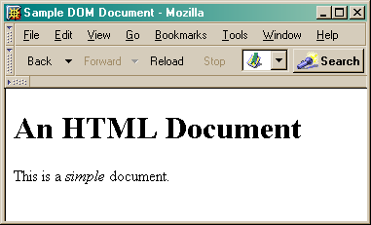
<html>
<head>
<title>Sample DOM Document</title>
</head>
<body>
<h1>An HTML Document</h1>
<p>This is a <i>simple</i> document.
</body>
</html>
This is what the browser displays on screen.

Slide 34
Document
This is a drawing of the model that the browser is working with for the page.
<html>
<head>
<body>
<title>
"Sample DOM Document"
<h1>
<p>
"An HTML Document"
"This is a"
<i>
"document"
"simple"

Slide 35
Why is this useful?
Because we can access the model too!
the model is made available to scripts running in the browser, not just the browser itself
A script can find things out about the state of the page
A script can change things in response to events, including user requests
We have already used this capability in the GUI programming that we've done

Slide 36
Power of JavaScript Using DOM
JavaScript can change all the HTML elements in the page
JavaScript can change all the HTML attributes in the page
JavaScript can change all the CSS styles in the page
JavaScript can remove existing HTML elements and attributes
JavaScript can add new HTML elements and attributes
JavaScript can react to all existing HTML events in the page
JavaScript can create new HTML events in the page

Slide 37
Dom Methods
Method | Description
document.body | Returns documents body
document.createElement() | Create the element node
document.forms | Returns collection of all form element in document
document.elementById() | Returns element has ID attributes with specific value
document.getElementByName() | Returns node list containing all element with specific value
document.open() | Open HTML output stream to collect output from document.write
document.write() | It writes the specified string on document.

Slide 38
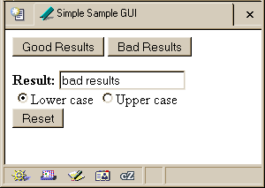
Recall our simple GUI example
This GUI has several simple controls.
Two buttons to control the results
One text field to display the results
One pair of radio buttons to control the display
One button to reinitialize

Slide 39
setResults(resultString)
<script type="text/javascript">
function setResults(resultString) {
var tempString = resultString;
if (document.getElementById("radioLC").checked) {
tempString = tempString.toLowerCase();
} else if (document.getElementById("radioUC").checked) {
tempString = tempString.toUpperCase();
}
document.getElementById("resultField").value = tempString;
}
</script>
the highlighted script above makes reference to several objects in the document object model

Slide 40
document.getElementById("radioLC").checked
Reference to several nodes in the model of the page that the browser constructed
document
The root of the tree is an object of type HTML Document
Using the global variable document, we can access all the nodes in the tree, as well as useful functions and other global information
title, referrer, domain, URL, body, images, links, forms, ...
open, write, close, getElementById, ...

Slide 41
Some information from a document
<html>
<head>
<title>DOM Sample 1</title>
</head>
<body>
Information about this document.<br>
<script type="text/javascript">
document.write("<br>Title: ",document.title);
document.write("<br>Referrer: ",document.referrer);
document.write("<br>Domain: ",document.domain);
document.write("<br>URL: ",document.URL);
</script>
</body>
</html>
Notes:
Show dom1.html

Slide 42
document.getElementById("radioLC").checked
getElementById("radioLC")
This is a predefined function that makes use of the id that can be defined for any element in the page
An id must be unique in the page, so only one element is ever returned by this function
The argument to getElementById specifies which element is being requested

Slide 43
Some information about elements
<html>
<head>
<title>DOM Sample B</title>
<script type="text/javascript">
function showInfo() {
var element = document.getElementById("opener");
var buffer = element.id + " tag is " + element.tagName;
alert(buffer);
element = document.getElementById("actionItem");
buffer = element.id + " tag is " + element.tagName;
buffer += ", type is "+element.type;
alert(buffer);
}
</script>
</head>
<body>
<p id="opener">The id attribute is very helpful.</p>
<p id="closer">This is the closing paragraph.</p>
<form>
<button id="actionItem" type="button" onclick="showInfo()">Show Info</button>
</form>
</body>
</html>
Notes:
Note Element doesn't refer to the value! Just the element. We have to explicitly ask for the value or the attribute values (see above).

Slide 44
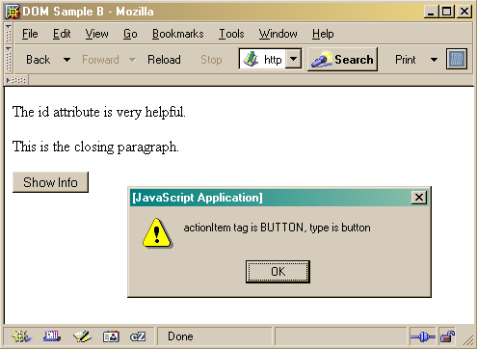
Notes:
Show demo DOM-SampleB.html

Slide 45
document.getElementById("radioLC").checked
checked
This is a particular property of the node we are looking at, in this case, a radio button
Each type of node has its own set of properties
for radio button: checked, name, ...
refer to the HTML DOM for specifics for each element type
Some properties can be both read and set

Slide 46
Some specific properties
<head>
<title>Simple Sample GUI</title>
<script type="text/javascript">
function setResults(resultString) {
var tempString = resultString;
if (document.getElementById("radioLC").checked) {
tempString = tempString.toLowerCase();
} else if (document.getElementById("radioUC").checked) {
tempString = tempString.toUpperCase();
}
document.getElementById("resultField").value = tempString;
}
</script>
</head>

Slide 47
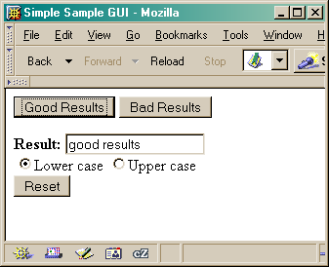

Slide 48
Getting vs. Setting
var oldvalue = document.getElementById("resultField").value;
document.getElementById("resultField").value = "new value";

Slide 49
Just the tip of the DOM
The HTML Document Object Model is a standard for structuring data on a web page
The field is advancing rapidly as people recognize the benefits of standardized structure and access
The DOM is steadily improving to cover general purpose data structuring requirements
XML (Extendible Markup Language) also uses the Core DOM to specify its structured data
similar to HTML but more carefully defined

Slide 50
This is what the browser reads (dom3.html).
<html>
<head>
<title>DOM Sample 3</title>
<script type="text/javascript">
var switchCount = 0;
var adjectives = ["simple","complex","fascinating","unique"];
function switcher() {
if (switchCount == (adjectives.length - 1))
switchCount = 0;
else
switchCount++;
var italicNode = document.getElementById("adjPhrase");
italicNode.firstChild.nodeValue = adjectives[switchCount];
}
</script>
</head>
<body>
<h1>An HTML Document</h1>
<p>This is a <i id="adjPhrase">simple</i> document.
<form>
<button type="button" onclick="switcher()">switch</button>
</form>
</body>
</html>

Slide 51
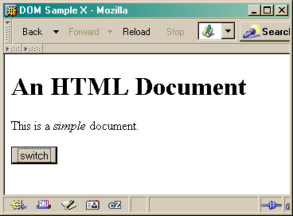
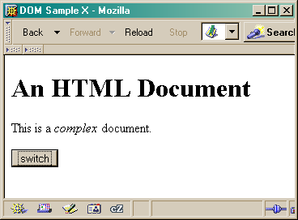

This is what the browser displays on screen.
Notes:
Show demo dom3.html

